Slide 1
Introduction to PSOC™ Edge E84
Getting Started with the Development Ecosystem
(E2)
Notes:
Hello attendees, a warm welcome to all of you. This presentation provides an overview of the development ecosystem and resources available for PSOC Edge E84.
It also explains how to get started on PSOC Edge E84 through code examples at the end of the presentation.

Slide 2
Agenda
Development ecosystem for PSOC™ Edge E84
    Resources ( Documentation / Application Notes )
    Firmware / Application Development ( ModusToolbox™, DEEPCRAFT™ )
Code Example #1: Hello World + Blinky
Code Example #2: IPC Semaphores using PDL API
Notes:
Now let us look at today’s agenda. We will cover the
Development Ecosystem for PSOC™ Edge E84
Some technical details related to Boot sequence, device life cycle, and memory layouts discuss through the relevant sections
Code Example 1 – Hello World
Code Example 2 – IPC Queues using HAL

Slide 3
PSOC™ Edge E84 Resources
PSOC™ Edge E84 MCU
Datasheets
Reference manuals (RM): architecture and registers
Application notes
Code examples
Development kits
KBAs and community forum
Notes:
Here is the list of PSOC Edge E84 resources. Resources play a vital role in the success of any product.
[Press Enter for animation] PSOC™ Edge E84 MCU product page for PSOC™ Edge E84 MCU related documents
[Press Enter for animation] PSOC™ Edge E84 MCU datasheets that describe and provide electrical specifications for each device family
[Press Enter for animation] Technical reference manuals (TRMs) provide detailed descriptions of the architecture and registers in each device family.
[Press Enter for animation] Application notes and Code examples cover a broad range of topics, from basic to advanced. You can browse our collection of application notes and code examples

Slide 4
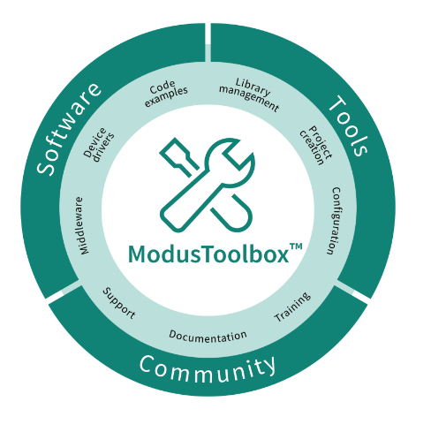
Firmware / Application Development
ModusToolbox™ provides
  Development environment for Infineon MCUs
  Flexible set of tools for project and system
  level configuration
  Low-level drivers
  Libraries
  Operating system support (Linux, macOS,
    Windows)
    Reference link : https://www.infineon.com/ModusToolboxInstallguide
Notes:
For Firmware or application development, development tools are necessary.
ModusToolbox™ Software is a modern, extensible development environment supporting a wide range of Infineon MCUs, including PSOC Edge E84.
The ModusToolbox™ tools package includes tools and configurators for creating your application, managing it and configuring your device. This means you choose your compiler, IDE, RTOS, and ecosystem without compromising usability and can create applications easily to leverage our industry-leading CAPSENSE™ (Human-Machine Interface), AIROC™ Wi-Fi and Bluetooth®, security, and various other features.
It also comes with the build system infrastructure that helps you control the build flow and build your application using make across platforms.

Slide 5
Support for IDEs
ModusToolbox™
IDE Tool Support
ModusToolbox™
IDE Tool Support
Eclipse IDE
Eclipse IDE for ModusToolbox™
Visual Studio
Code
Visual Studio
Code
Arm® MDK
µVision
IAR
Embedded
Workbench
Arm® MDK
with µVision IDE
IAR
Embedded Workbench
Command-line Interface
Command-line Interface
Embedded Workbench and µVision require additional post-build step configuration.
Details documented within IDE respective user manuals
Notes:
ModusToolbox™ software supports 3rd-party IDEs like Eclipse IDE, Visual Studio Code, Arm® MDK (μVision), and IAR Embedded Workbench. The tools package includes Eclipse IDE for your convenience. Additionally, a command line interface is also available for developers who prefer working without a graphical interface.
In the next section of this video walk through tools like Project Creator, Library Manager, and a few of the configurators available in ModusToolbox for PSOC Edge Development.

Slide 6
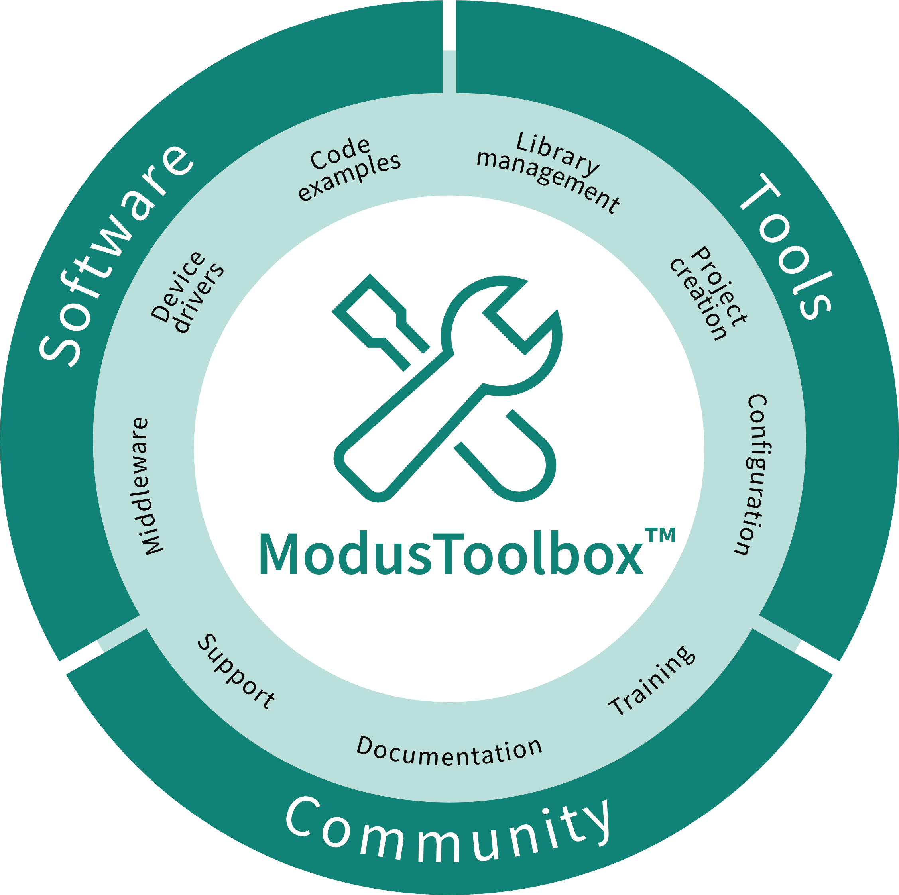

Understanding ModusToolbox™ and Zephyr
Provides a targeted ecosystem focused on development of Infineon devices.
Provides a community driven ecosystem with support for a targeted set of MCUs from a wide range of silicon providers.
IDE support, including Eclipse IDE,
VS Code, and 3rd party IDEs.
Support for GCC, IAR, and Arm compilers using ‘make’ based ModusToolbox™ build system.
Graphical UI configurations tool
Leverages Infineon developed low-level drivers, middleware abstraction, middleware, and code examples.
Enables key partner middleware via ModusToolbox™ & Friends program
Targeted at command-line users with some community support for VS Code.
Default support for GCC compiler using ‘west’ based Zephyr build environment. Additional toolchains are now being supported.
Text-based configuration via devicetree and Kconfig
Leverages vendor provided device support; Infineon support based on low-level drivers.
Community contributed middleware, with support for Zephyr defined driver API, stacks, and RTOS.

Slide 7
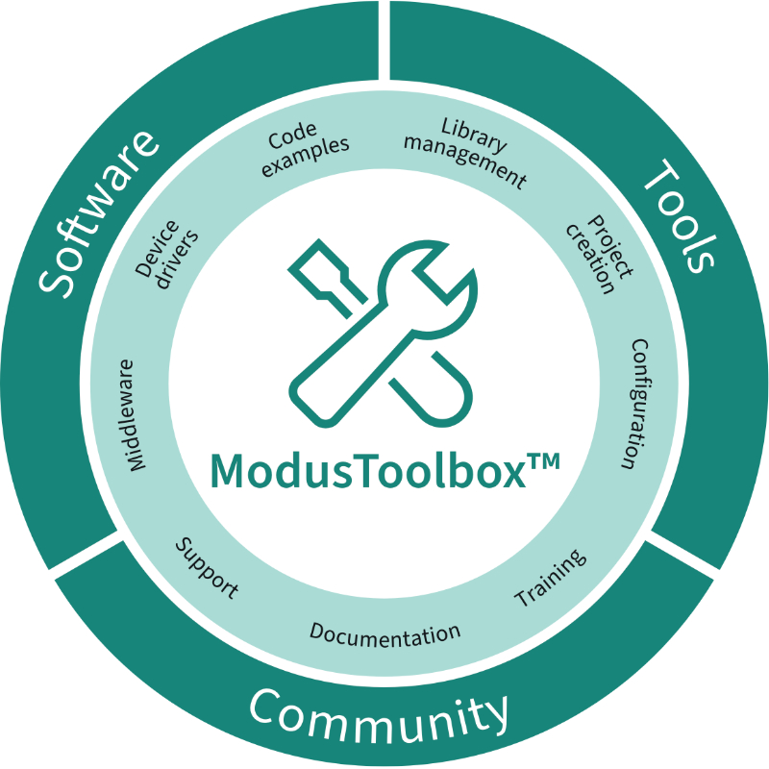

Overview of DEEPCRAFT™ Studio and ModusToolbox™ workflow
Installation of ModusToolbox™ and DEEPCRAFT™ supported within the ModusToolbox™ Setup program
Code Examples aligned with DEEPCRAFT™ Studio Accelerator projects for IMU, Vibration, and Microphone
Code Examples aligned with DEEPCRAFT™ Studio Data Collection with Graph UX
Code Examples aligned with DEEPCRAFT™ Model Converter Profiling
Project connector files in ModusToolbox™ applications with Quick Panel shortcuts for linking to DEEPCRAFT™ Studio Projects
Integration of ModusToolbox™ Project Creator, supporting coordinated DEEPCRAFT™ Studio and ModusToolbox™ project creation
Integration ModusToolbox™ Machine Learning Core Tools (ml-coretools), leveraged during Infineon device specific code generations and optimization
ModusToolbox™ project detection and selection during model code generation

Slide 8
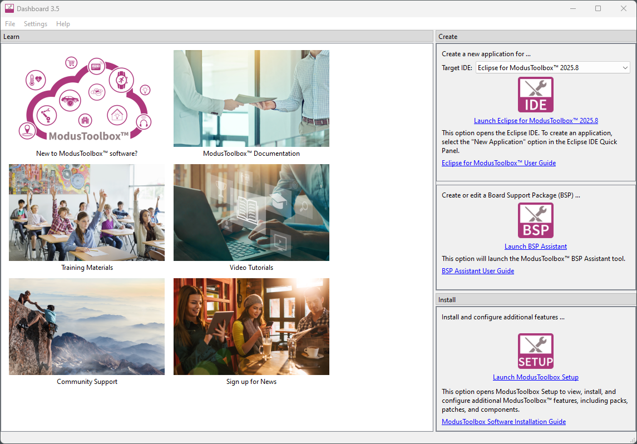
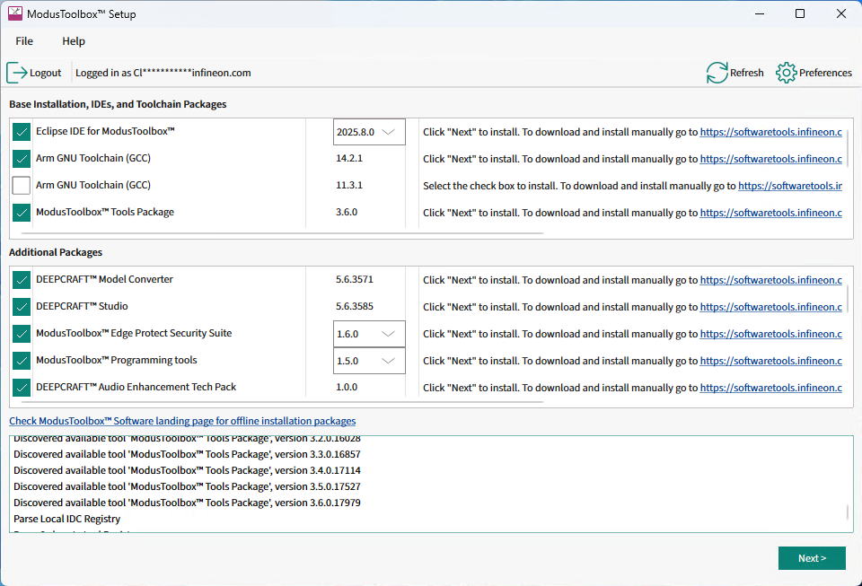
Installation support within ModusToolbox Setup
ModusToolbox™ Setup program can be used to install and manage DEEPCRAFT™ applications, including Studio, Model Converter, and Audio Enhancement Tech Pack

Slide 9
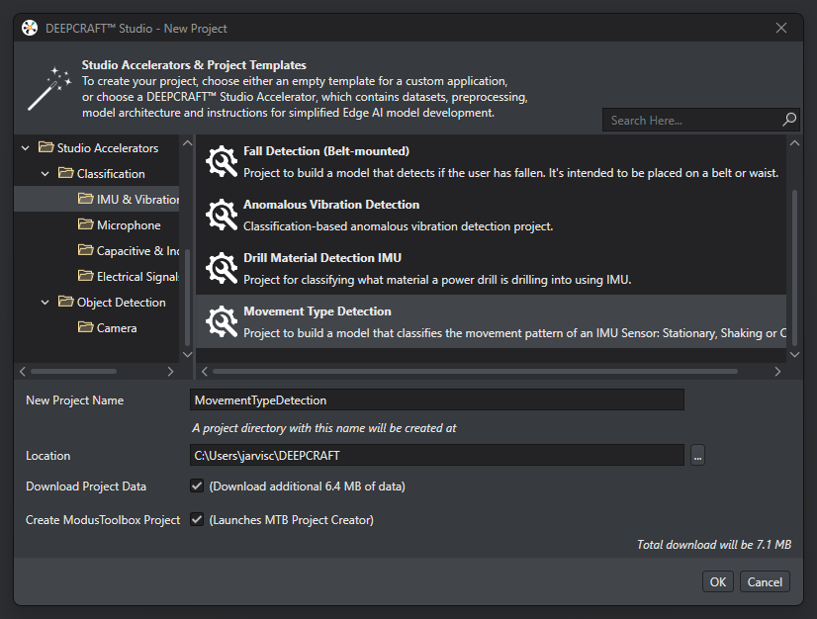
Code Examples with DEEPCRAFT™ and ModusToolbox™
When creating a new DEEPCRAFT™ Studio project, a ModusToolbox™ project can be created at the same time.
DEEPCRAFT™ Studio includes Studio Accelerator projects that align with ModusToolbox™ code examples, enabling models generated from Studio to be more easily leveraged within a ModusToolbox™ application.
ModusToolbox™ code examples include DEEPCRAFT™ Deploy Audio and Deploy Motions applications.

Slide 10
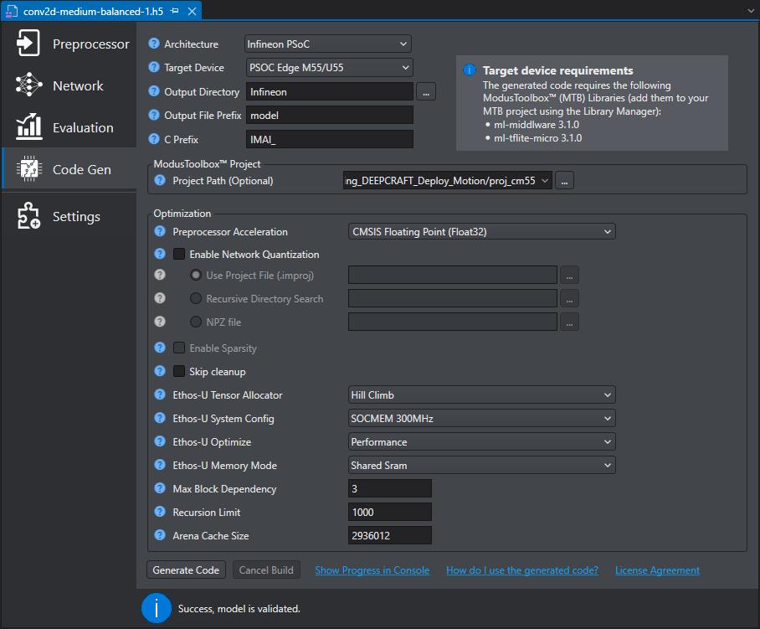
DEEPCRAFT™ Studio Model Code Generation
DEEPCRAFT™ Studio code generation dialog includes pre-defined architecture selections for Infineon devices, including PSOC™ Edge E84
DEEPCRAFT™ Studio code generation integrates the ModusToolbox™ Machine Learning Core Tools (ml-coretool) with integrated Vela compiler supporting PSOC™ Edge E84.
Selection of Infineon device enables project selection of the connected ModusToolbox™ project and core specific project path.
Selected ModusToolbox™ project path will be used during the code generation step to enable iterative model development and updates.

Slide 11
Tools utilized in this presentation
  ModusToolbox™ v3.6
  Eclipse IDE for ModusToolbox™ v2025.4.0
  Edge Protect Security Suite v1.6
  ModusToolbox™ Programming Tools v1.5.0
  KIT_PSE84_EVAL_EPC2 BSP v1.0.0
  Terminal Emulator
  KIT_PSE84_EVAL revG
Key documentation leveraged in this video
AN235935 – Getting started with PSOC™ Edge E84 on ModusToolbox™ software
ModusToolbox™ PSE8xxGP Device Support Library (DSL)

Slide 12
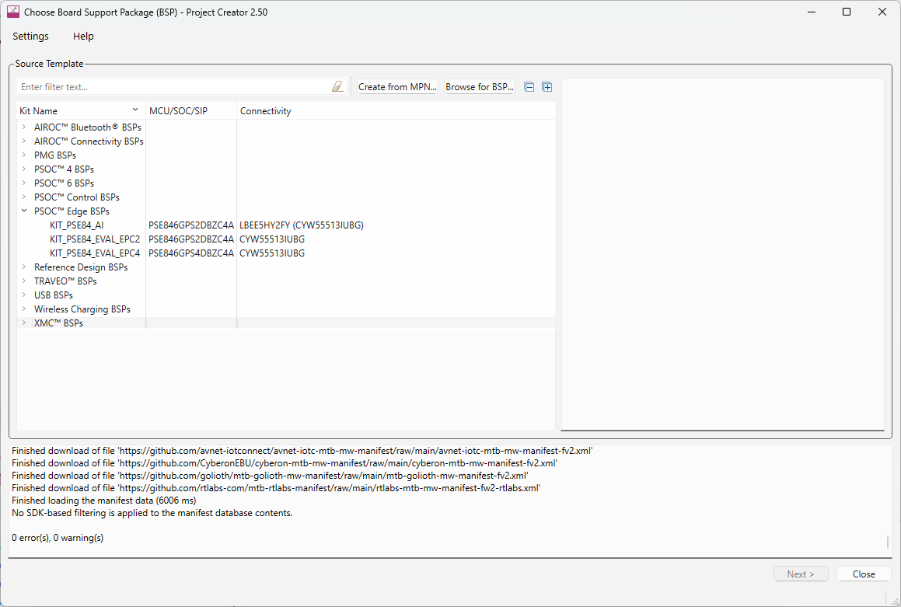
Project Creator
Notes:
(Will show actual tool)
At first, we have the Project Creator tool.
The Project Creator tool is used to create applications targeting specific Board Support Packages (BSPs) from available code example templates.
It is available both as a graphical user interface (GUI) and a command-line interface (CLI) to create applications for use in any software environment as per preference.
To launch Project Creator,
Open Eclipse IDE for ModusToolbox™
[Press Enter for animation] Launch Project Creator by clicking New Application in the Quick Panel
[Press Enter for animation] Project Creator lists all the BSPs you can select from
[Press Enter for animation] The PSOC Edge E84 MCU development kit is listed as KIT_PSOCE84_EVAL_EPC2 under PSOC Edge BSPs. We will be using this in our training, please take note of it.
You can also launch the tool standalone by running the executable of the tool.

Slide 13
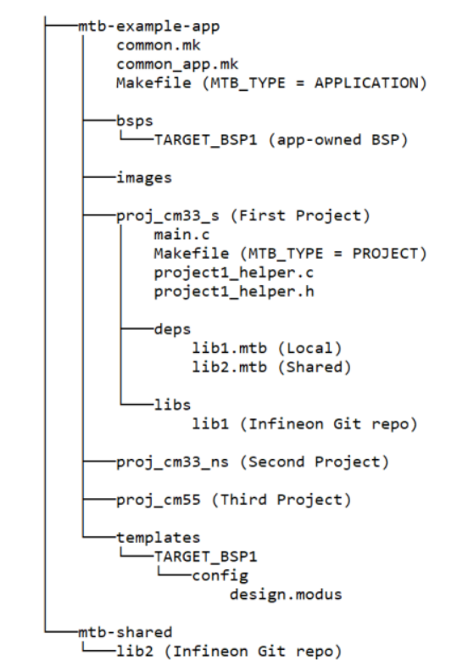
Understanding the Application Structure
Notes:
(Will show actual tool)
After creating an application, it will be located in a top-level container, or workspace directory, that contains multiple files, one or more application directories, plus a mtb_shared directory.
A typical PSOC edge application contains three projects: Proj_cm33_s (s stands for secure), Proj_cm33_ns (s stands for non secure) and proj_CM55
common.mk :
This makefile is shared across all projects. It contains variables including: MTB_TYPE, TARGET,TOOLCHAIN, and CONFIG. In this case, we have a multi-project structure for all Explorer MCU applications, hence MTB_TYPE=PROJECT. This file includes a reference to the common_app.mk file
common_app.mk
This makefile is shared across the entire application and all its projects. It contains path information to indicate the location of the installation tools_version directory
Application Level Makefile
An application contains a Makefile which is in the application's root folder. This file contains the set of directives that the make tool uses to compile and link the application project. This Makefile contains the MTB_TYPE variable set to APPLICATION, plus the MTB_PROJECTS variable to specify the included projects. This file also includes the common_app.mk file and the path information to the application.mk file in the installation tools_<version> directory. This is responsible for forwarding build-related requests to the individual core projects and dealing with post-build activities (for example, generating single monolithic HEX files that can be used to program all projects simultaneously) when they are complete.
bsps folder
The bsps folder is common to all projects in a multi-core application. The files provided by the BSP are present here and are listed under TARGET_<bsp name> sub-folders. All the input files for the device and peripheral configurators are in the config folder inside the BSP. The Generated Source folder in the BSP contains the files that are generated by the configurators and are prefixed with cycfg_. These files contain the design configuration as defined by the BSP. From ModusToolbox™ 3.x or later, you can directly customize configurator files of BSP for your application rather than overriding the default design configurator files with custom design configurator files since BSPs are completely owned by the application.
The BSP folder also contains the linker scripts and the start-up code for the Explorer MCU used on the board.
main.c file
This is the file containing the source code of the project. Each project has its own source code file. If a project has multiple source code files, they can be grouped under a "source" folder
Project Level Makefile
This is the project's Makefile. It includes numerous variables used for the projects, such as COMPONENTS, CORE, CORE_NAME, and other variables used to specify flags and pre-build and post build commands. This file also includes path information for source code discovery, shared repo location, and path to the
complier. Plus, it includes the common.mk file from the application and the path information to the start.mk file in the installation tools_ directory
libs folder
The libs folder also contains .mtb files. In this case, they point to libraries that are included indirectly as a dependency of a BSP or another library. For each indirect dependency, the Library Manager places an .mtb file in this folder. These files have been populated based on the targets available in deps folder. For example using BSP KIT_PSOCE84_EVK populates libs folder with the following .mtb files:cmsis.mtb, core-lib.mtb, core-make.mtb, mtb-hal-cat1.mtb, mtb-pdl-cat1.mtb, recipe-make-cat1d.mtb The libs folder contains the file mtb.mk, which stores the relative paths of the all the libraries required by the application. The build system uses this file to find all the libraries required by the application. Everything in the libs folder is generated by the Library Manager so you should not manually edit
anything in that folder
build folder
The build folder contains all the artifacts resulting from a build of the project. The output files are organized by target BSPs
deps folder
The deps folder contains .mtb files, which provide the locations from which ModusToolbox' pulls the libraries that are directly referenced by the application. These files typically each contain the GitHub location of a library. The .mtb files also contain a git Commit Hash or Tag that tells which version of the
library is to be fetched and a path as to where the library should be stored locally
For example, Here, retarget-io.mtb points to mtb://retarget-io#latest-v1.X#$$ASSET_REPO$$/retarget-io/latest-v1.X. The variable $$ASSET_REPO$$ points to the root of the shared location which defaults to mtb_shared. If the library must be local to the application instead of shared, use $$LOCAL$$ instead
of $$ASSET_REPO$$.This subdirectory also contains the locking_commit.log file, which keeps track of the version for each dependent library
mtb_shared folder
By default, when creating a new application or adding a library to an existing application and specifying it as shared, all libraries are placed in an mtb_shared directory adjacent to the application directories.The mtb_shared folder is shared between different applications within a workspace. Different
applications may use different versions of shared libraries if necessary Each workspace you create with one or more applications will include a mtb_shared directory adjacent to the application directories, and this is where the shared libraries are cloned by default. This location can be modified by specifying the CY_GETLIBS_PATH variable. Duplicate libraries are checked to see if they point to the same commit, and if so, only one copy is kept in the mtb_shared directory. You can regenerate these files using the Library Manager as and when needed
Similar project structure can be observed in our created hello world project

Slide 14
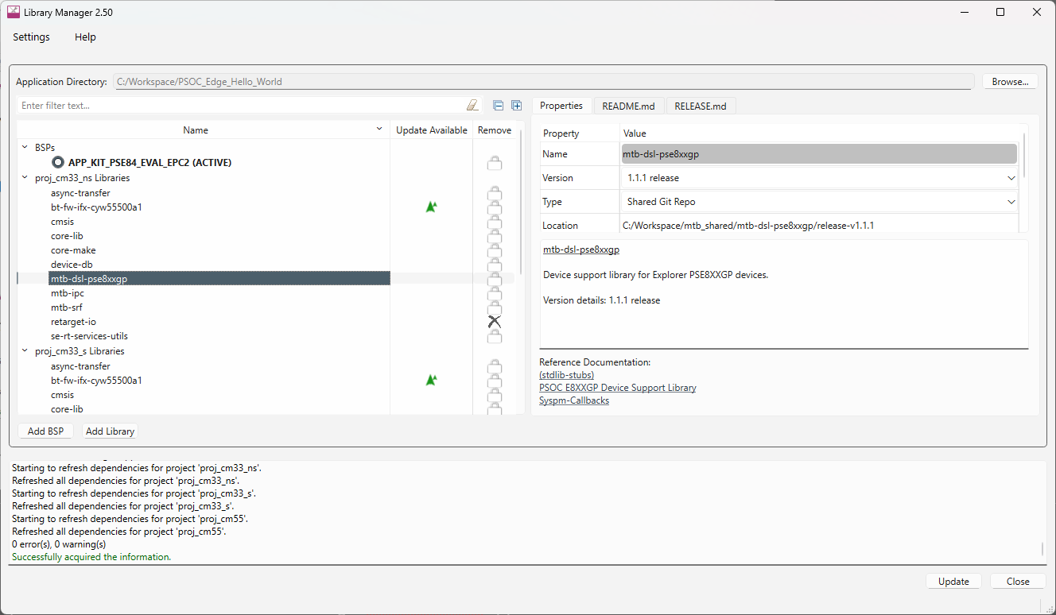
Library Manager
Notes:
(Will show actual tool)
Next we have the Library Manager
The Library Manager provides a GUI to select which Board Support Package (BSP) and version should be used when building a ModusToolbox application.
The tool also allows you to add and remove libraries, as well as change their versions for the selected project. This way you can easily manage libraries without having to create a new project.
Launch library manager from windows. Click Browse and point to the application directory.
[Press Enter for animation] The tool will list all the libraries, middleware's and BSP’s added for each project in the application
[Press Enter for animation] Once you click on particular library, Properties tab on the right hand side shows the details of the library like name, version, type etc. Specific versions can be selected using the properties tab
[Press Enter for animation] More BSPs can be added using “Add BSP”,
[Press Enter for animation] More libraries can be added using “Add library”
[Press Enter for animation] Once all the changes are made, click on Update for changes to reflect in your project

Slide 15
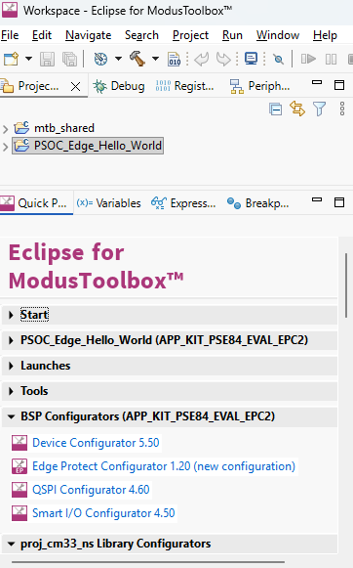
BSP Configurators
Device Configurator
QSPI Configurator
Smart I/O Configurator
Edge Protect Configurator
Configurators
  Creates structures needed for peripherals
  used by PDL
Notes:
(Will show actual tool)
Moving on to configurators
Modus Toolbox™ software provides configurators that make it easier to configure a hardware block. Some functionalities include
• Setting options and generating code to configure drivers
• Setting up connections such as pins and clocks for a peripheral
• Setting options and generating code to configure middleware
For PSOC™ Edge E84 MCU applications are supported by many configurators such as Device, ML, USB, QSPI Configurators, etc.
NOTE : Configurators make initial setup easier for hardware accessed using the PDL. The configurators create structures that the PDL requires. You don’t need to know the exact composition of each structure. If you use the HAL for a peripheral, it creates the necessary structures – called HAL objects - for you, so you should NOT use a configurator to set them up. HAL objects are accessible; after you initialize a peripheral with the HAL you can view and modify the object.
[Press Enter for animation] Quick panel list all configurators or Right click on project on select ModusToolbox™
option for list of configurators
Lets look at the configurators in detail

Slide 16
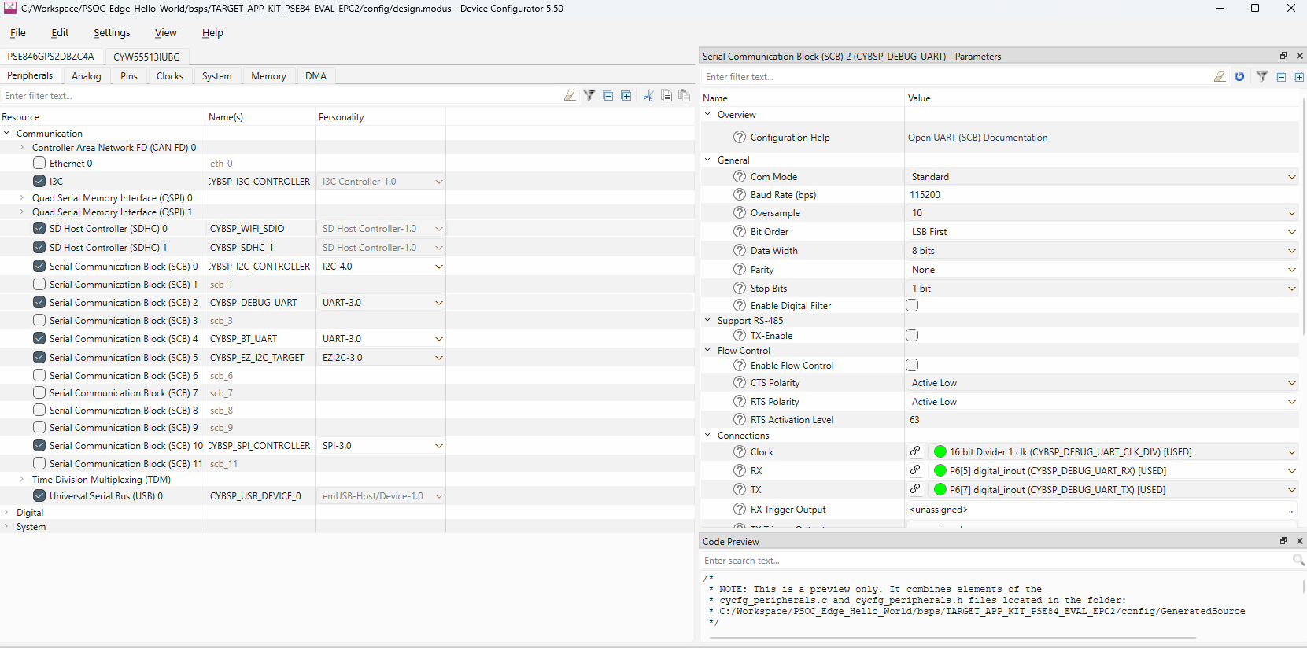
Device Configurator
Notes:
(Will show actual tool)
Device Configurator helps in setting up the system-level functions, pins, and basic peripherals like UART, Timer, PWM, etc.
The Device Configurator GUI contains menus, icons, tabs, and several panes used to configure MCU peripherals. Let’s look at a few important ones.
[Press Enter for animation] Peripherals tab: The Peripherals tab is where you enable various analog, digital, system, and communication peripherals for the device to include in your application.
[Press Enter for animation] By selecting the specific peripheral as shown here - “serial communication block (SCB) 1 with UART”, a parameter pane on the right-hand side shows up and contains all the parameters for the enabled resource.

Slide 17
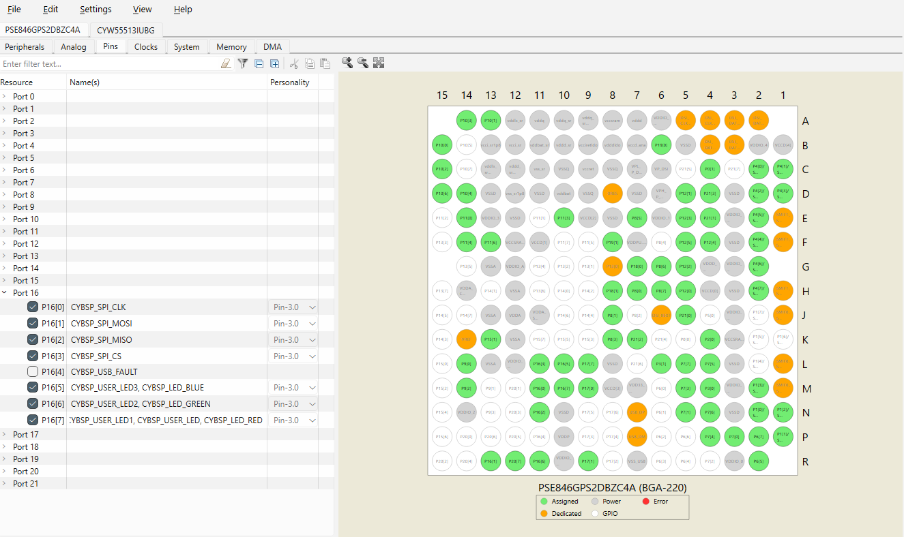
Device Configurator contd…
Notes:
(Will show actual tool)
[Press Enter for animation] The Pins tab is where you configure all the pin-related settings. All available pins are shown in an expandable tree, arranged by port number.
[Press Enter for animation] The interactive pin package diagram shows the different states of the pins; there is a legend on the diagram. You can enable/disable a pin by double-clicking it in the diagram.
Pin states are shown in different colors: ◼ White – GPIO ◼ Green – Assigned ◼ Grey – Power/ground pins ◼ Orange – Fixed function pins ◼ Red – Error state ◼ Semi-transparent – Indicates the hardware resource has been locked.

Slide 18
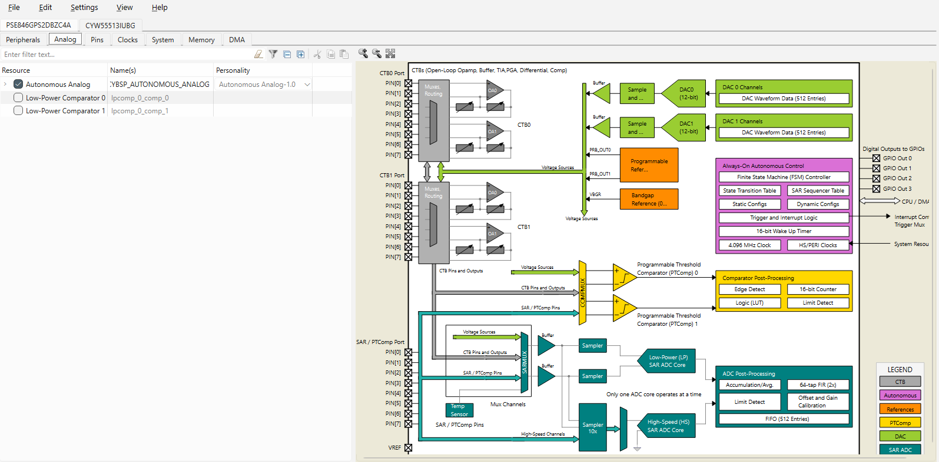
Device Configurator contd…
Notes:
(Will show actual tool)
[Press Enter for animation] The Analog and Analog-Routing tabs help configure the various analog resources in your application. Enabled resources are indicated in green.
The Analog Routing allows you to manually edit the routing of analog resources in your application. It also provides the ability to lock down all or some of the results.

Slide 19
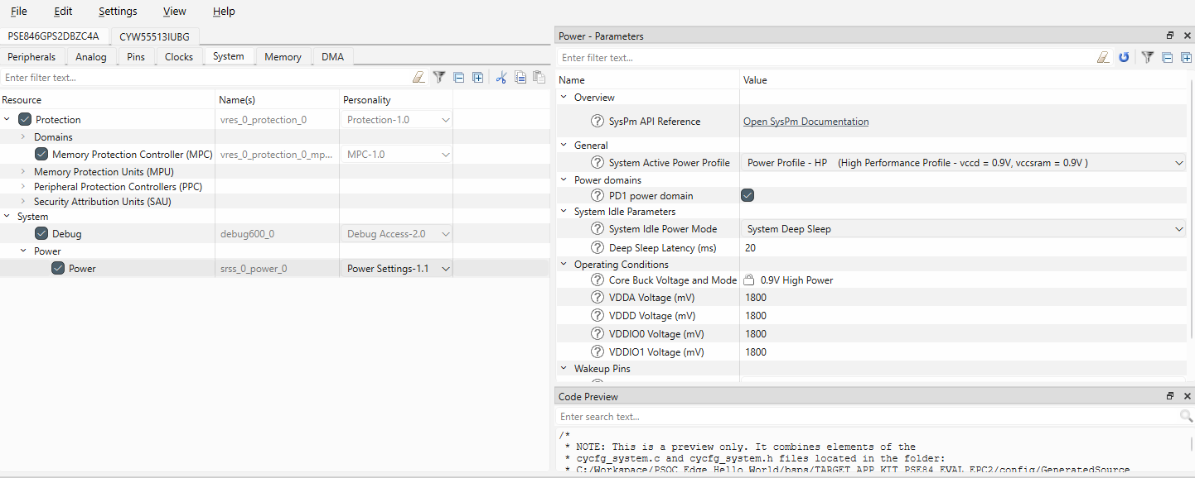
Device Configurator contd…
Notes:
(Will show actual tool)
[Press Enter for animation] The System tab provides access to system-level functions, such as system clocks, power management, and debug interfaces.
The interactive clock diagram shows all the system clocks and how they connect to each other. You can enable/disable a clock by double-clicking it in the diagram. Enabled clocks are green, disabled clocks are white, and clocks in error state are red

Slide 20
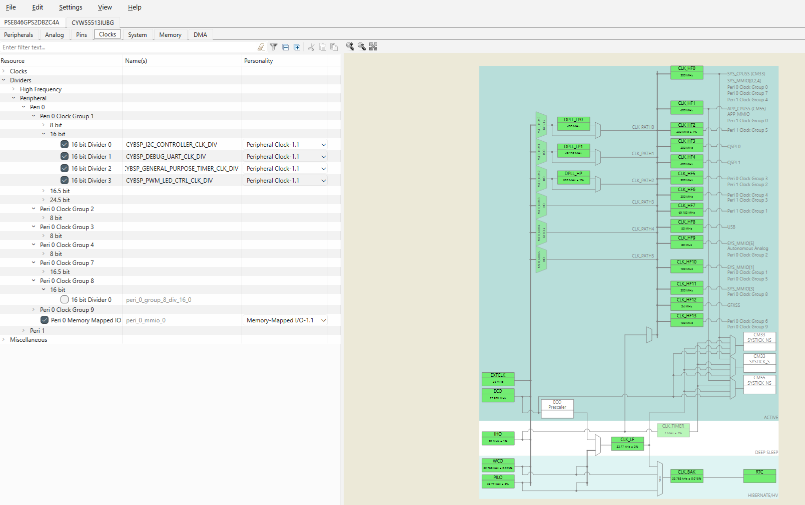
Device Configurator contd…
Notes:
(Will show actual tool)
[Press Enter for animation] The System tab provides access to system-level functions, such as system clocks, power management, and debug interfaces.
The interactive clock diagram shows all the system clocks and how they connect to each other. You can enable/disable a clock by double-clicking it in the diagram. Enabled clocks are green, disabled clocks are white, and clocks in error state are red

Slide 21
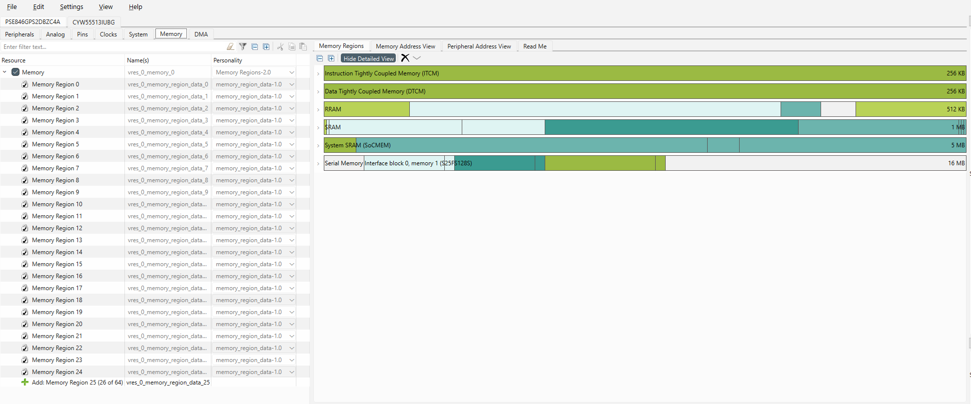
Device Configurator contd…
Notes:
(Will show actual tool)
[Press Enter for animation] The Memory tab provided access to the various memory regions to enable, disable, or create additional regions. Some memory regions cannot be modified.
The Memory Regions view shows a detailed view of types of memory allocated and their associated size.

Slide 22
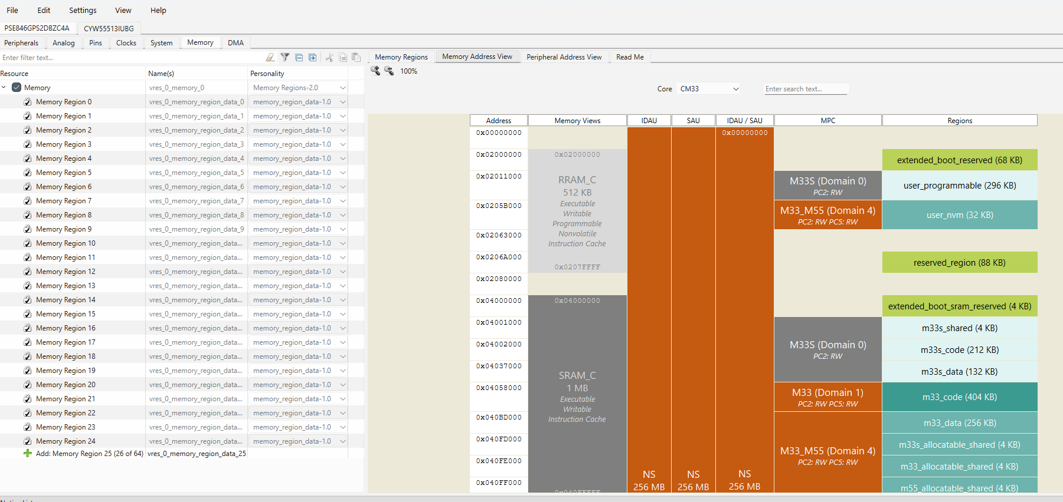
Device Configurator contd…
Notes:
(Will show actual tool)
[Press Enter for animation] The Memory tab provided access to the various memory regions to enable, disable, or create additional regions. Some memory regions cannot be modified.
The Memory Address View shows the memory map for the various cores and how the IDAU, SAU, and MPC are configured along with the associated regions.

Slide 23
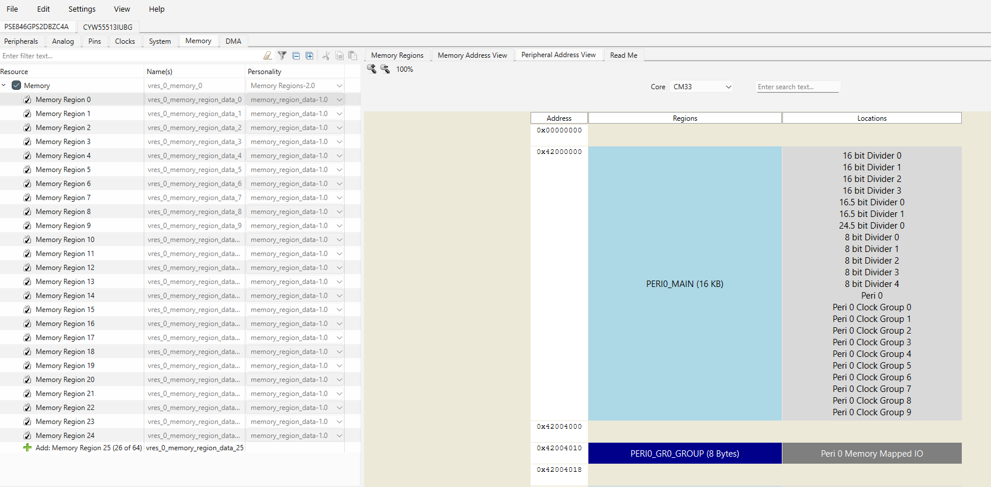
Device Configurator contd…
Notes:
(Will show actual tool)
[Press Enter for animation] The Memory tab provided access to the various memory regions to enable, disable, or create additional regions. Some memory regions cannot be modified.
The Peripheral Address View shows the memory map for the various cores and peripheral region and location.

Slide 24
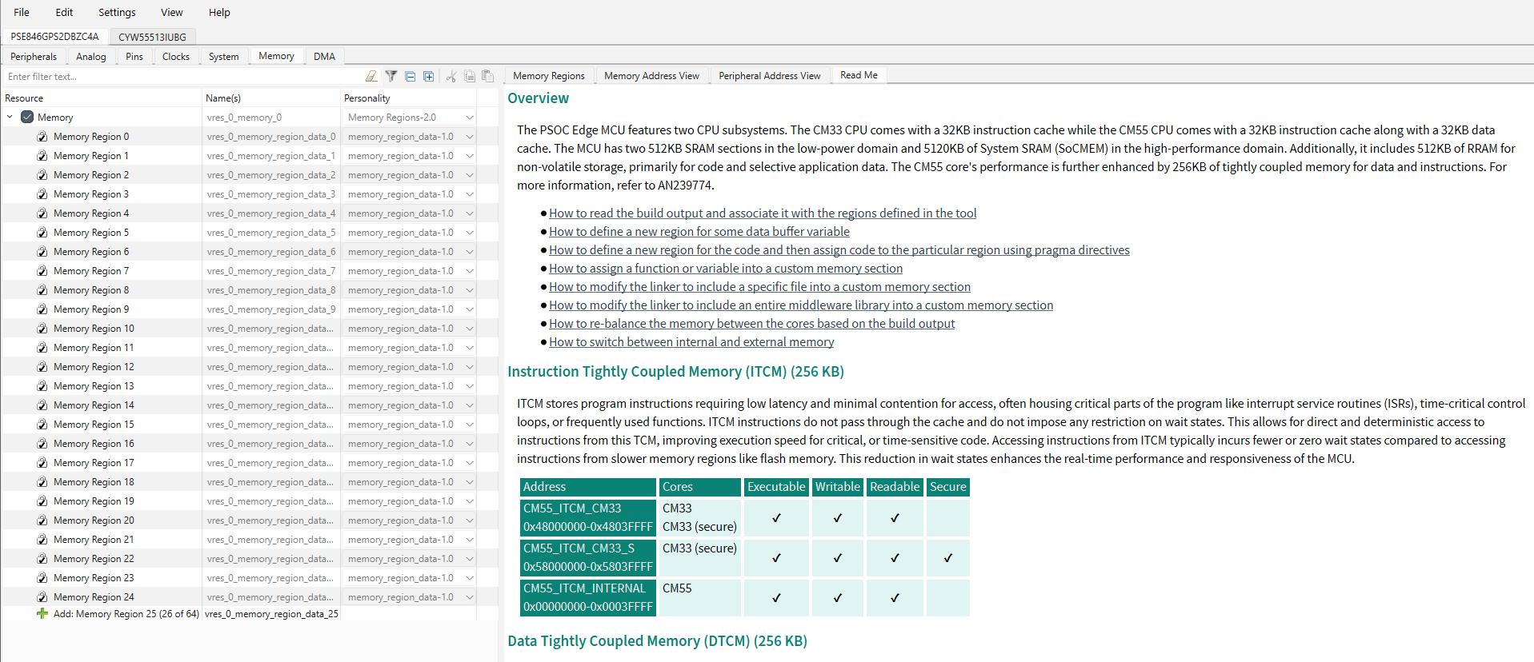
Device Configurator contd…
Notes:
(Will show actual tool)
[Press Enter for animation] The Memory tab provided access to the various memory regions to enable, disable, or create additional regions. Some memory regions cannot be modified.
The Read Me tab gives you an overview of the various types of memory and links to various How Tos when configuring and utilizing the various memories.

Slide 25
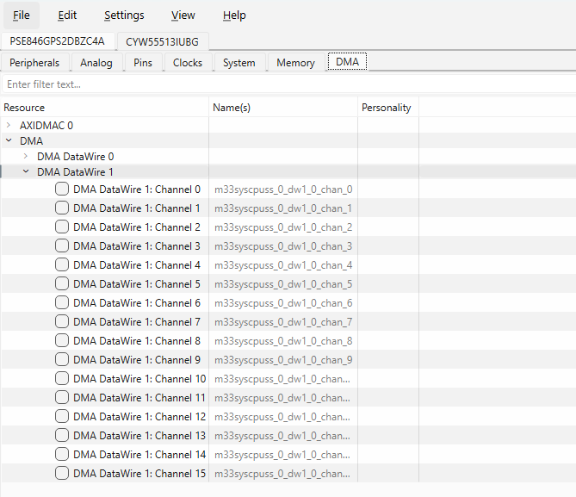
Device Configurator contd…
Notes:
(Will show actual tool)
[Press Enter for animation]
The DMA tab lists all the DMA resources in the design
The Device Configurator saves configuration information in a design.modus file, which contains all the required information about the device and the application. When you save changes, the Device Configurator generates/updates firmware in the BSP’s "GeneratedSource" folder

Slide 26
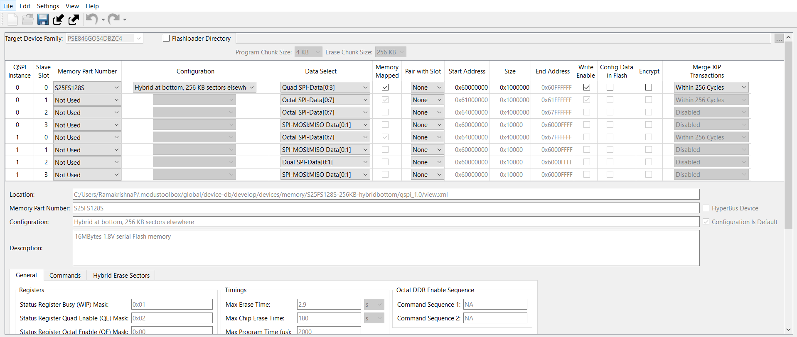
QSPI Configurator
Notes:
(Will show actual tool)
Now let’s look at the QSPI Configurator
The Quad Serial Peripheral Interface (QSPI) Configurator helps configure external memories and generate code for easy integration into the application. You can open or create memory configuration files, configure memory slots, and generate code for your application.
The CAT1D category of devices where PSOC Edge E84 MCUs fall under, supports extending the default RAM and flash with external memory chips of the following types: flash, non-volatile FRAM, or RAM.
The QSPI Configurator holds information about the set of default memory parts. However, if your specific memory part is not present, you can create a new one.
The QSPI Configurator saves configuration information in a .cyqspi file, which contains all the required information about the device and the application. When you save changes, the QSPI Configurator generates/updates firmware in the BSP’s "GeneratedSource" folder.

Slide 27
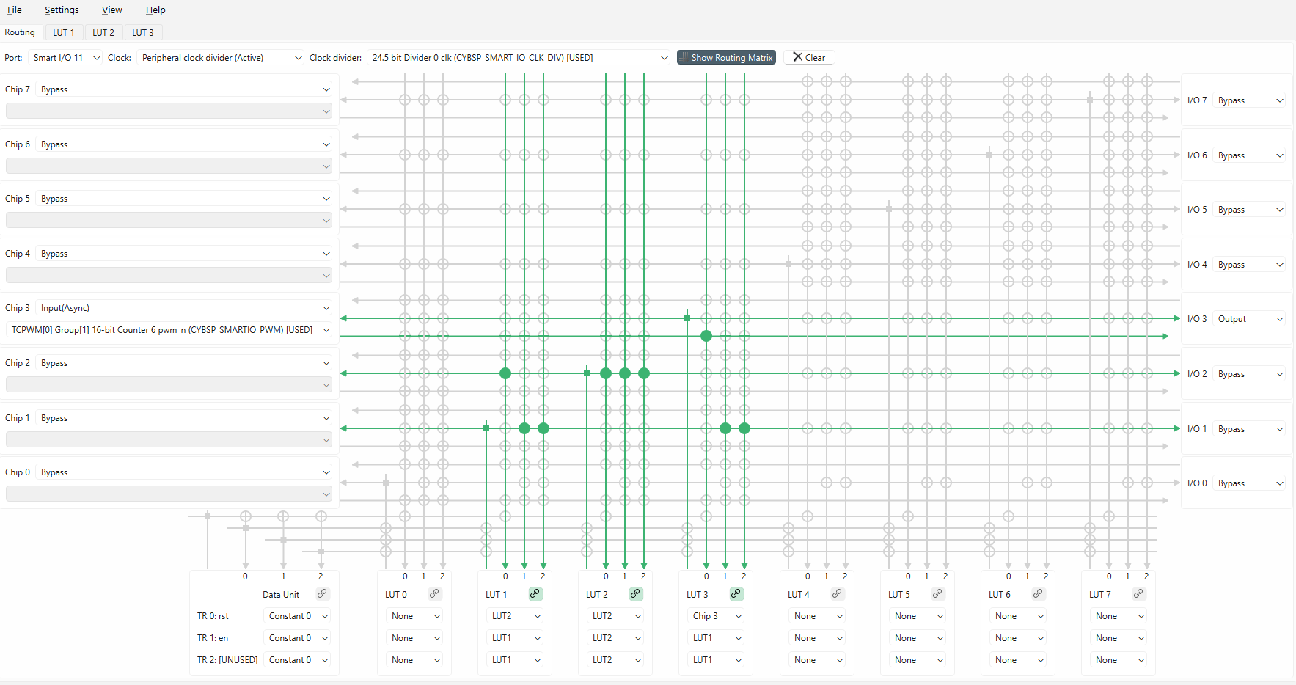
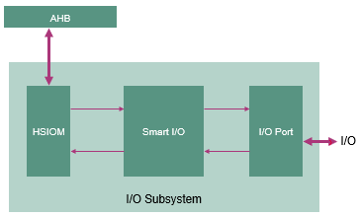
SMART I/O Configurator
Notes:
(Will show actual tool – need to leverage overlay)
Moving further, we have the SMART I/O Configurator
The Smart I/O Configurator is part of a collection of tools included in the ModusToolbox software. It provides a GUI to configure the Smart I/O.
The Smart I/O block adds programmable logic to an I/O port.
[Press Enter for animation]
It is positioned in the signal path between the highspeed I/O matrix (HSIOM) and the I/O port. The HSIOM multiplexes the output signals from fixed-function peripherals and the CPU to a specific port pin and vice-versa. The Smart I/O block is placed on this signal path, acting as a bridge that can process signals between port pins and the HSIOM.
There are several areas in the GUI to configure signals: Chip, I/O, Data Unit, and LUT. Inputs to the chip from the I/O port can be logically operated upon before being routed to the peripheral blocks or internal connections of the chip. Likewise, outputs from the peripheral blocks or internal connections of the chip can be logically operated upon before being routed to the I/O port.

Slide 28
Application Booting sequence
Boot starts from Secured Enclave as the Root of Trust
Off-the-shelf extended boot software
  Boot from RRAM or external flash
  Alternate serial interface for recovery boot
  SRAM loading for enhanced security
Optional MCUboot based Edge Protect Bootloader
One time revocable OEM RoT Key
Notes:
The PSOC™ Edge E84 secured boot process starts with BOOT_ROM. As a root-of-trust (RoT), it entails the next
level software authentication through the public key cryptography to ensure that only authorized software is
loaded and executed on the device
Secured enclave boot
The PSOC™ Edge E84 secured enclave is based on the lock-step Cortex® -M0+ CPU, coupled with dedicated local
ROM, SRAM, and islands of replication of hardware cryptographic accelerators. The secured enclave has
exclusive access to the sensitive data on the device. It is isolated from the rest of the system and provides a
secured environment for secure boot and PSA-compliant cryptographic services. APPCPUSS and SYSCPUSS can
communicate with the secured enclave through a tightly-controlled IPC mechanism. The secure enclave
decides what information should be shared in response to an IPC request.
The secured enclave provides multi-stage booting through immutable ROM_BOOT and RRAM_BOOT.
Together, BOOT_ROM and RRAM_BOOT offer the following functionality.
• Implements a hardware RoT in protection-context 0 and provides an immutable trust anchor based on
authorization from Infineon
• Applies the trims and performs authentication of Extended Boot and launches them on successful
authentication
• Authenticates and launches the SE RAMApps (Secured Enclave RAMApps) and enables the device
provisioning
• Facilitates “secured debug” by enforcing access restrictions on the debug access port (SWD/JTAG)
• Provides PSA-compliant Crypto services for Application CPUs
Extended Boot
Extended Boot is the first code executed by the CM33 CPU of PSOC™ Edge E84. The secured enclave boot
software authenticates the Extended Boot image on RRAM, and launches it if authentication is successful.
Devices are shipped out from Infineon in development lifecycles. In this lifecycles, Extended Boot is pre-programmed into
the device, but not locked down.
The stock version of the Extended Boot offers the serial interface (I2C, SPI,
UART and USB) capability. Infineon also releases a version of Extended Boot without alternate serial
interfaces, which reduces the footprint on RRAM. As long as the device is in development lifecycles, Extended Boot
can be re-programmed via the secured enclave RAMApps provided by Infineon. Extended Boot gets locked
down when device transitions to production lifecycle. Note that since Secured Enclave can only authenticate
Infineon-signed versions of Extended Boot , it is mandatory to use Infineon-released versions
Extended Boot launches CM33 Secure project present in RRAM from a fixed location, which then configures external QSPI flash in XIP mode and launches CM33 Non-Secure application. Additionally CM33 Non-Secure application enables CM55 CPU and launches the CM55 application in external flash.

Slide 29
Device lifecycle and provisioning
Development
  Shipped from Infineon
  Provision with OEM certificate and policy
  For OEM development; until production
Production
  One-time provisioning with “Production” certificate
  Re-provisioning if allowed by policy
RMA
  Transition from Development or Production
  Performed by Infineon signed SE Service Application
  Devices in RMA mode can be shipped to Infineon for field failure analysis
Notes:
Development :
PSOC Edge MCU is shipped from Infineon factory in the “Development” lifecycle. OEM can extend the ownership of the device by provisioning the device with OEM certificate.
Provisioning process installs the OEM keys; debug, boot, and system configuration policies; as well as the extended boot software
The development lifecycle is recommended for all development activity until the device is ready to go for production
In this lifecycle OEM can enable or disable the secure boot.
Production :
OEM can transition the device from “Development” to “Production” by provisioning the device with a OEM “Production certificate”.
Re-provisioning is possible if allowed by the policy
Secure boot is always enabled in this lifecycle
Most device assets are “frozen” in the production lifecycle and cannot be changed unless allowed by the re-provisioning policy.
Note: OEM certificate for provisioning is required to be signed by Infineon. Edge Protect Signing service can be availed to sign the certificate.
RMA :
Transition to RMA is possible from development and production lifecycle
It is performed by an SE Service application, which is provided by Infineon
Device in RMA mode can be shipped to Infineon for failure analysis

Slide 30
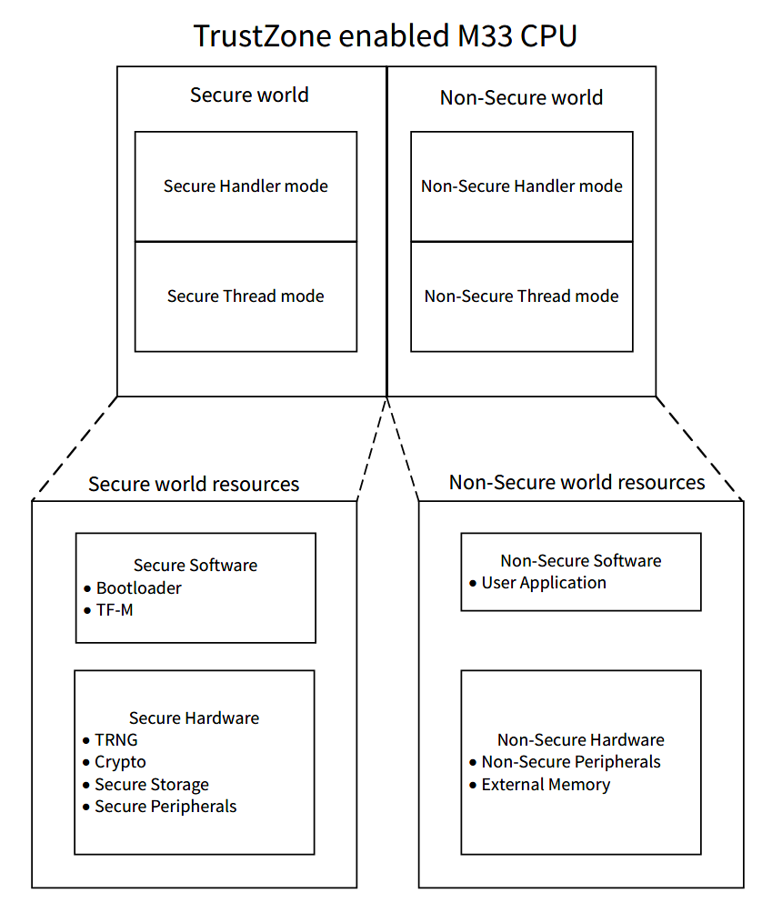
Secure and Non-Secure Operating Modes
• Arm® TrustZone- enabled Cortex® -M33 CPU
• Secure and non-secure CPU states
• Attribution units - Secure Attribution Unit (SAU) and Implementation Defined Attribution Unit (IDAU)
• Secure and non-secure aliasing of the memory map
• Secure and non-secure interrupts
• Banked resources between secure and non-secure states
• Secure and non-secure peripherals
• Secure and non-secure debug
Notes:
A security domain is a software abstraction that allows the grouping of resources into domains to isolate accesses between one another.
At isolation level 1, there’s two domains, the Secure Processing Environment (SPE) and Non-Secure Processing Environment (NSPE). The SPE represents in the Secure CM33 and the NSPE represents both the Non-Secure CM33 and Non-Secure CM55.
At isolation level 2, we drill down further into the SPE to isolate the Platform Root Of Trust and Application Root of Trust.
At isolation level 3, we isolate all the secure services that are offered as part of the Platform RoT and Application RoT.

Slide 31
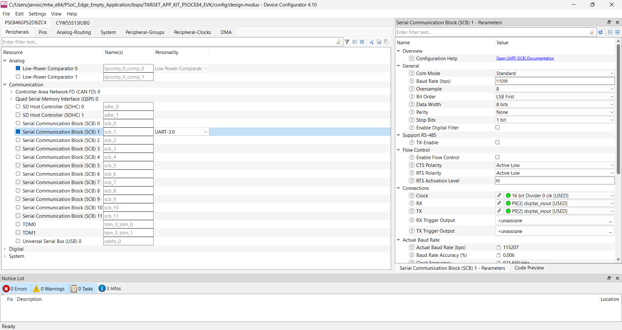
Security Domain Assignment
Security Domain
NSPE Domain
NSPE Domain
NSPE Domain
NSPE Domain
NSPE Domain
NSPE Domain
SPE Domain
NSPE Domain
NSPE Domain
SPE Domain
NSPE Domain
NSPE Domain
NSPE Domain
NSPE Domain
NSPE Domain
NSPE Domain
Notes:
All the resources can be assigned to a security domain in the device configurator to isolate them from one another.

Slide 32
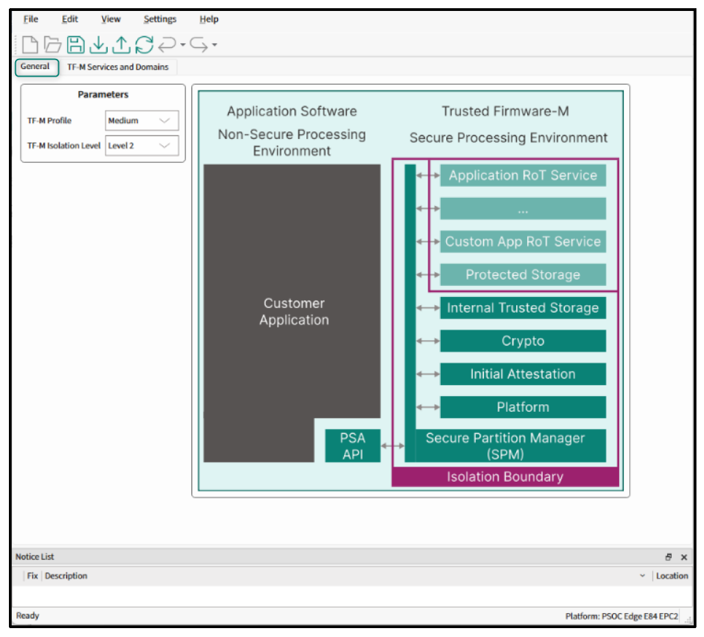
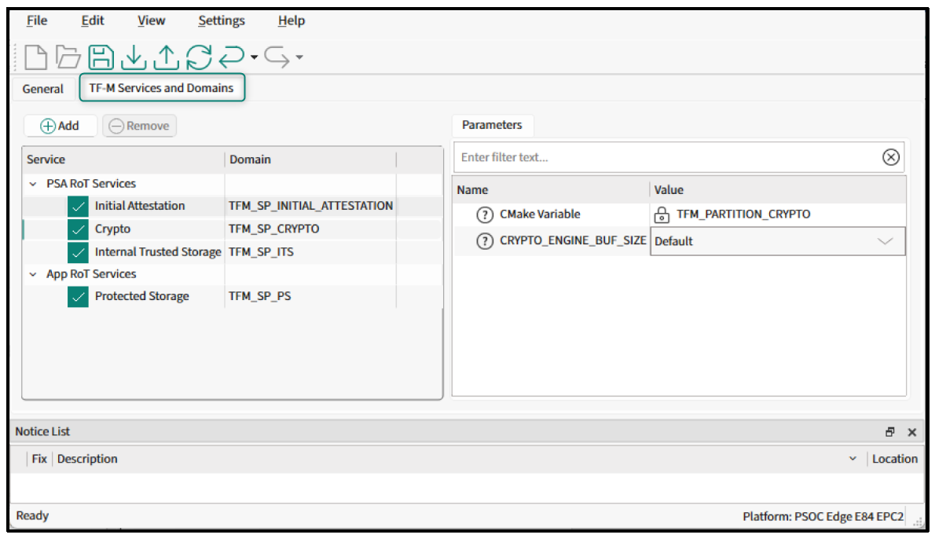
Edge Protect Configurator
TF-M Services and Domains tab
General tab

Slide 33
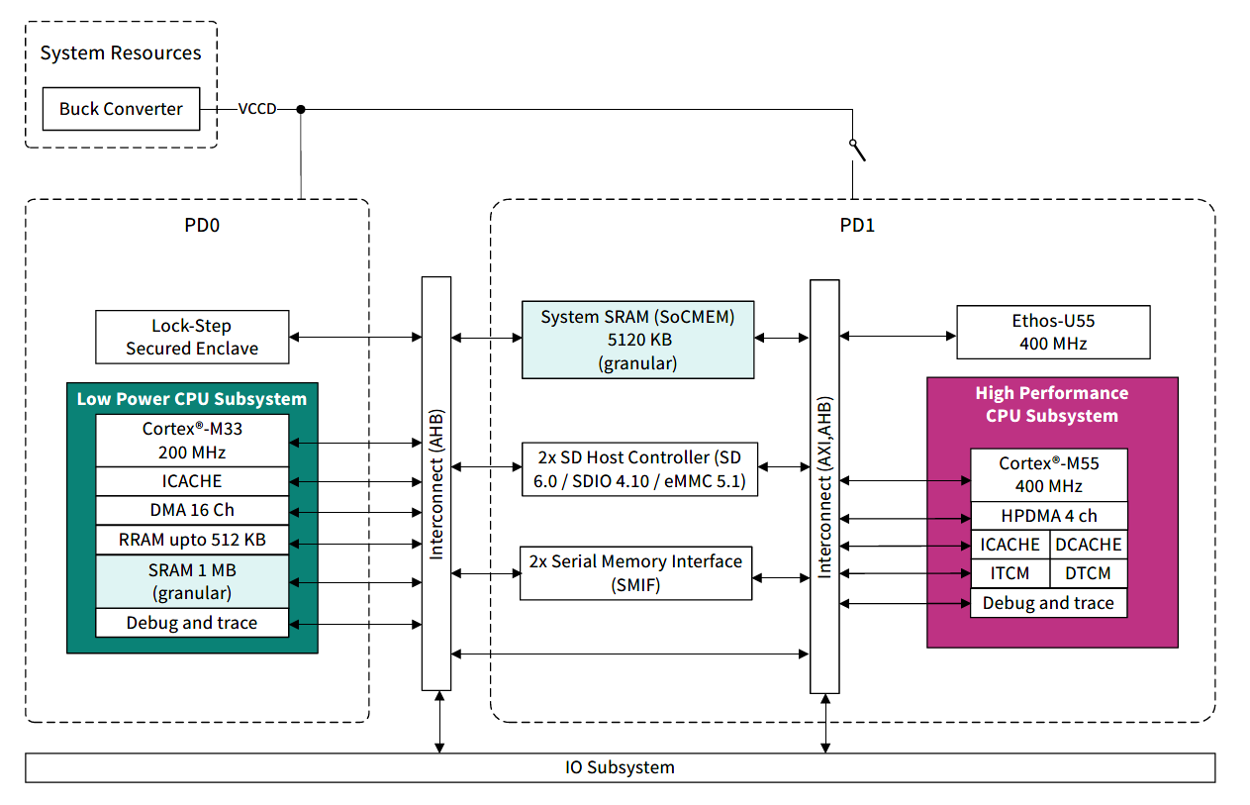
Memory Overview
2 CPU Subsystem
Each CPU equipped with cache
2 SRAM sections (1MB)
System SRAM (5120KB)
RRAM (512KB)*
ITCM and DTCM (256KB each)
SMIF0/1 (XIP capable) for external flash or RAM
* Some memory is reserved for extended boot and the secure application

Slide 34
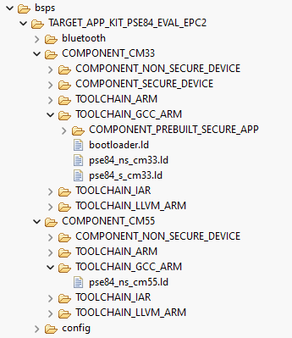
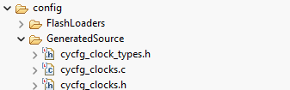
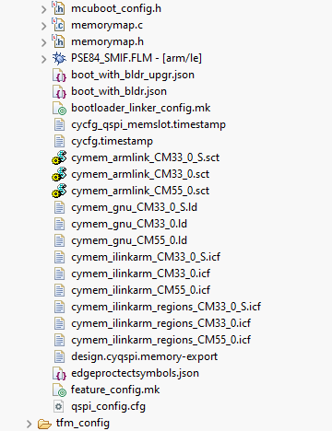
Linker Scripts
Four top-level linker files
  Bootloader
  CM33 Secure
  CM33 Nonsecure
  CM55
Three generated memory include files
  CM33 Secure
  CM33 Nonsecure
  CM55
Generated memory include files come from Device Configurator
New user defined memory regions require direct modification to top-level linker file to leverage generated content

Slide 35
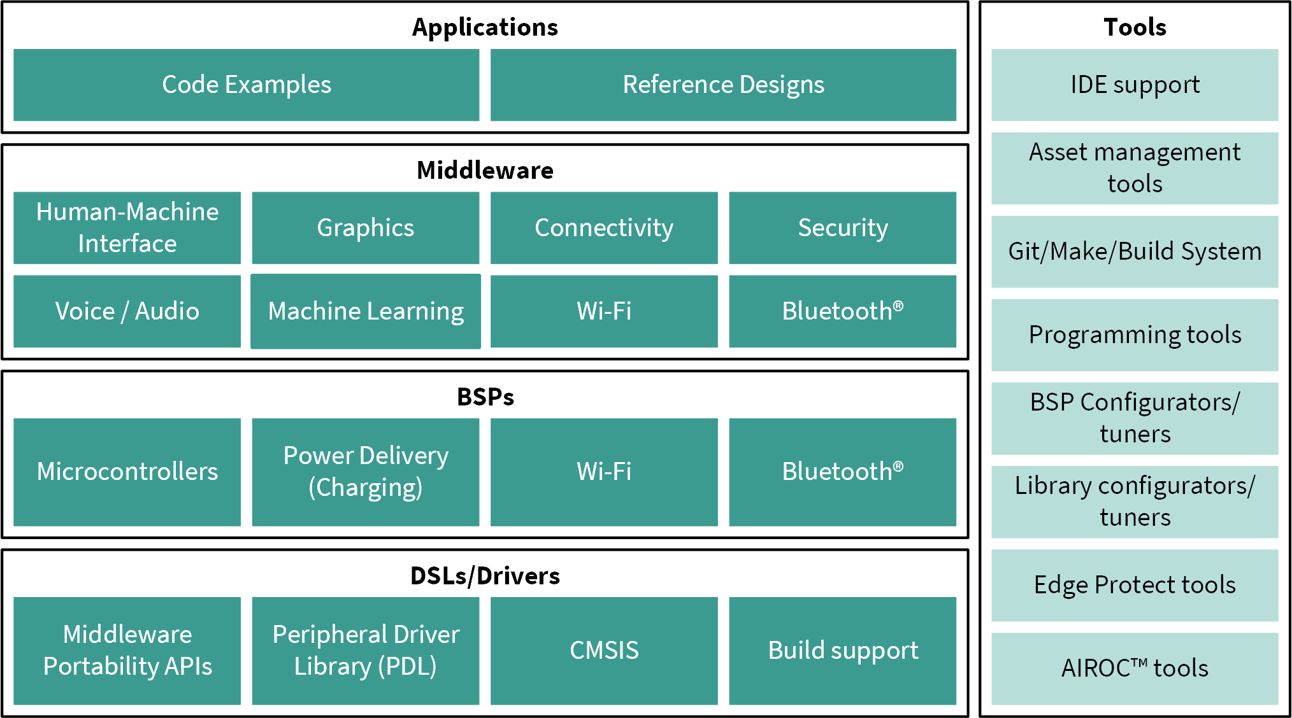
Firmware/application development :Software Resources
Applications
  Code examples
  Reference Designs
Middleware Libraries
Notes:
[Press Enter for animation] At the application level we provide code examples and reference designs that help you develop applications.
[Press Enter for animation] Next, the middleware provides an extensive set of libraries for different solutions including graphics, touch sensing, machine learning, USB, and security. They can be added to your application using the Library manager.

Slide 36
Firmware/application development : Software Resources
Middleware Portability APIs
  High-level APIs built on top of PDL
  Hardware generic, so more portable
  Architected to enable Infineon maintained middleware to work across a wider range of devices
  Replacement of the former ModusToolbox HAL layer
Notes:
Moving Further on Middleware Portability APIs
[Press Enter for animation]

Slide 37
Firmware/application development : Software Resources
Peripheral Driver Library (PDL)
  Set of low-level APIs
  Hardware specific so less portable
Notes:
Let’s now look at the available Software resources
The software stack in this figure illustrates the different components that makeup ModusToolbox.
[Press Enter for animation] The PDL contains a set of low-level APIs to control hardware peripherals such as UART and SPI. The interfaces are usually specific to a particular device. Since the PDL interacts with the hardware at a lower level it is less portable between devices.

Slide 38
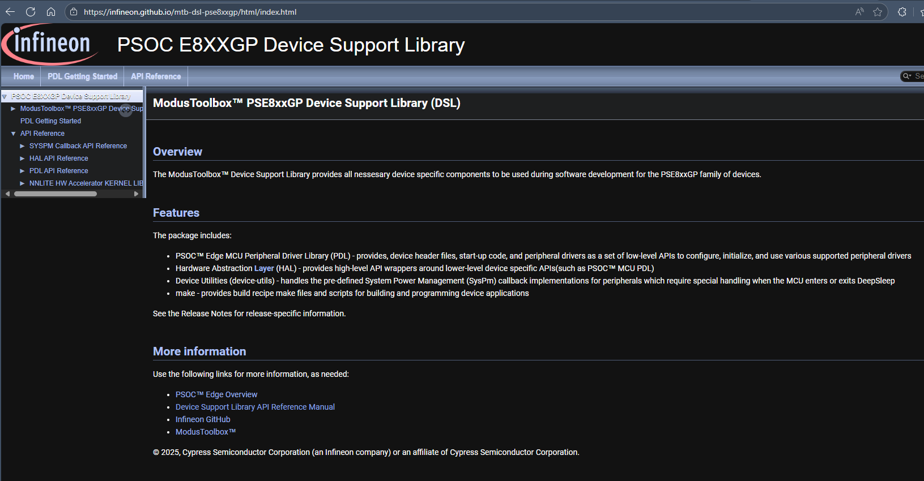
Firmware/application development : Software Resources
https://infineon.github.io/mtb-dsl-pse8xxgp/html/index.html
Notes:
To understand or to learn about the PDL APIs, refer to the PDL documentation
[Press Enter for animation] Here is the link for PDL documentation,

Slide 39
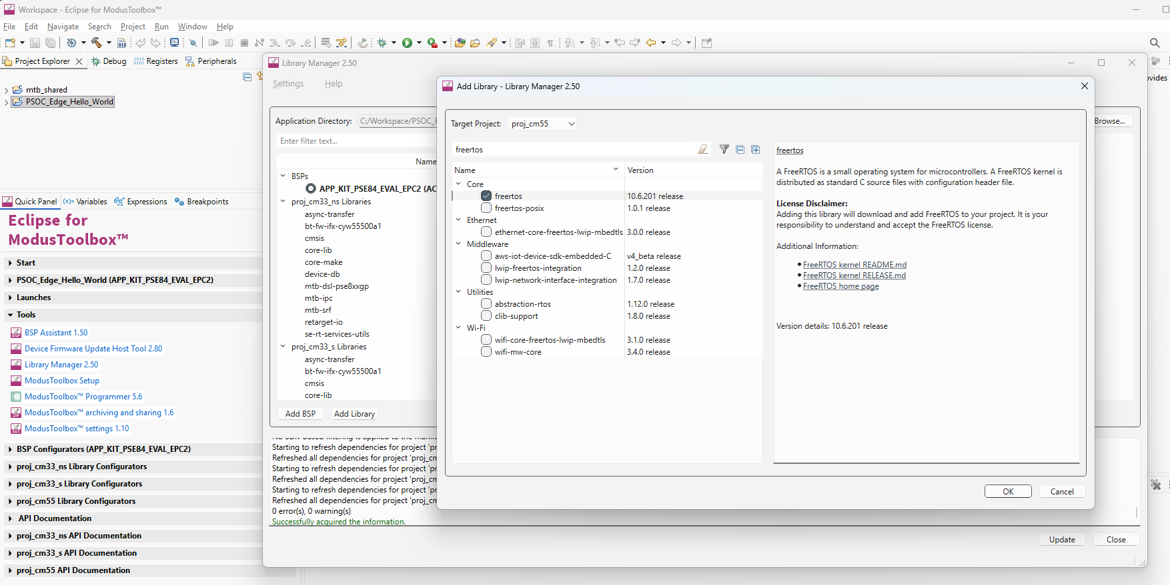
FreeRTOS support with ModusToolbox™
Notes:
(Will show actual tool)
Moving on lets look at how to add Freertos to your application
Adding native FreeRTOS support to a ModusToolbox™ application project is like adding any middleware library.
You can include the FreeRTOS middleware in your application by using the Library Manager.
If using the Eclipse IDE, select the application and
[Press Enter for animation] Click the Library Manager link in the Quick Panel.
[Press Enter for animation] Click Add Library and
[Press Enter for animation] Select freertos from the Core dialog.
[Press Enter for animation] Click OK and
[Press Enter for animation] Update

Slide 40
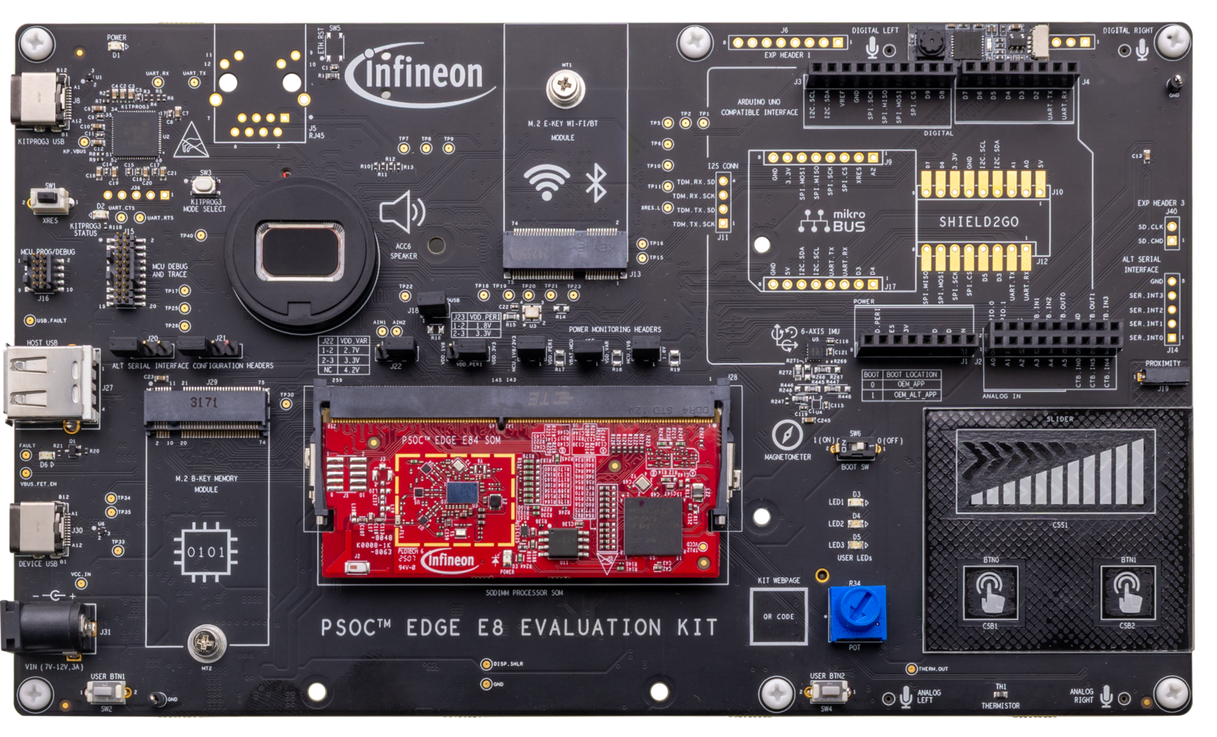
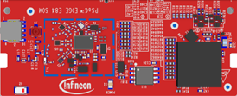
PSOC™ Edge E84 MCU development kit – Top View
Power LED
Ethernet RJ45; (DNI)
M.2 Radio Socket
I2S I/Os
(DNI)
mikroBUS socket (Click); (DNI)
I/O Headers
(DNI)
Arduino UNO socket
KitProg (P5LP)
KitProg USB
KitProg Mode Select Button
Sheild2GO socket;
(DNI)
Reset Button
ETM Header
Alt. Serial Interface;
(DNI)
SWD/JTAG Header (M33/M55/U55)
Proximity
Speaker
USB Host
IMU (Accelerometer + Gyro) &
Magnetometer
M.2 Memory Socket
Boot Select
Power Selection
Power Monitoring
CapSense Slider and Buttons
USB Device
DC Power Socket
User Button
*DNI – Do not insert / load
Processor SoM socket
Potentiometer
User Button
Thermistor
User LED (x3)
Notes:
Presenter will explain the features available in the board showing the board to the attendees

Slide 41
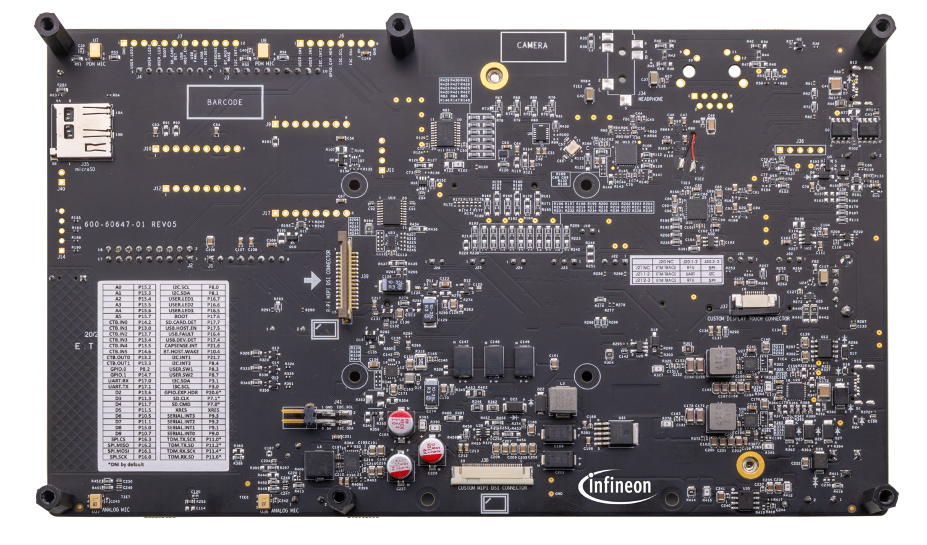
PSOC™ Edge E84 MCU development kit – Back View
DMIC
DMIC
Headphone Jack (DNI)
SD Card Socket
10” Display Touchpad connector
AMIC
AMIC
MIPI-DSI R-Pi Display connector
10” MIPI-DSI Display connector
Notes:
Presenter will explain the features available in the board showing the board to the attendees

Slide 42
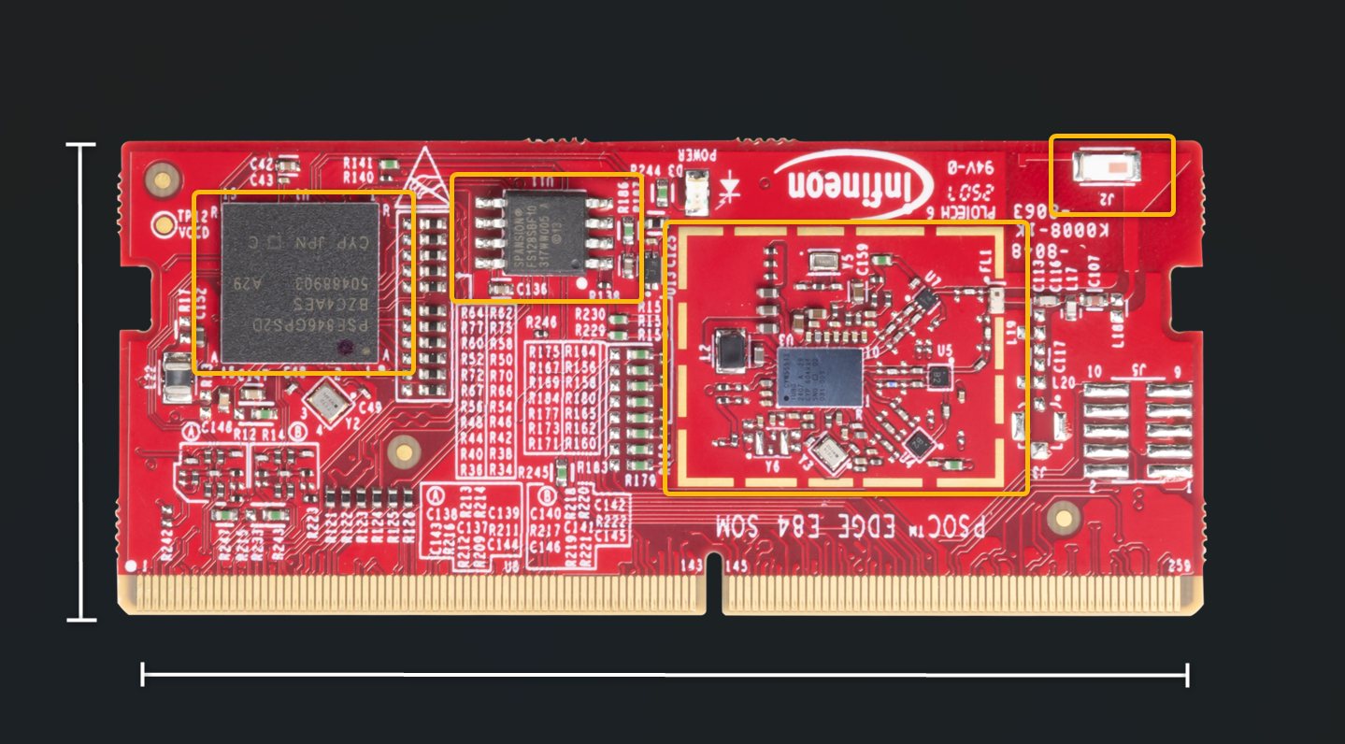
PSOC™ Edge E84 MCU SOM – Top View
PSOC Edge MCU (220-BGA)
QSPI Flash
CYW55513 Radio Section
Antenna
30mm
69.6mm
Notes:
Presenter will explain the features available in the board showing the board to the attendees

Slide 43
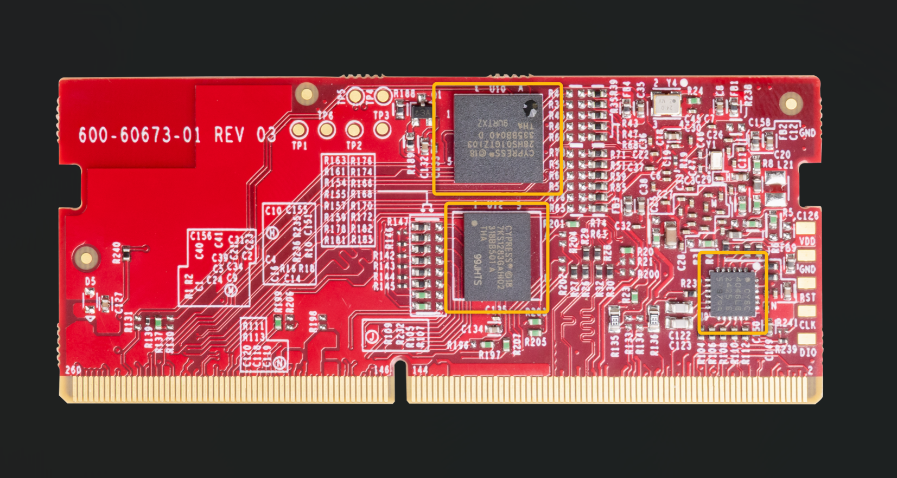
PSOC™ Edge E84 MCU SOM – Bottom View
Octal RAM
Octal Flash
CapSense Co-Processor
Notes:
Presenter will explain the features available in the board showing the board to the attendees

Slide 44
Programming/debugging
  Programming and Debugging PSOC™ Edge E84 MCU
    Comes with a KitProg3 onboard programmer and debugger
    Supports CMSIS-DAP
    Supports OpenOCD using a GDB server and the J-Link debug probe
    Debug environment is IDE specific – refer to MTB documentation.
Notes:
Let’s now look at programming and debugging
ModusToolbox supports programming the device and debugging your code.
The PSOC Edge development kit has a KitProg3 onboard programmer and debugger. It supports the Cortex Microcontroller Software Interface Standard - Debug Access Port or in short the CMSIS-DAP.
Programming and debugging are native to your chosen development environment. Infineon devices are supported in major program and development solutions such as J-Link and OpenOCD - Open On-Chip Debugger.
There are a few specifics to be aware of regarding Debugging with the Early Access Pack of PSOC Edge and ModusToolbox v3.1
Reference the Getting Started Guide for installation details (Python and Edge Protect Tools) and the Early Access Pack Release Notes for specific launch configuration details
Let’s see Debugging in action

Slide 45
Code Example #1:
Hello World + Blinky

Slide 46
Description of Hello World + Blinky example
Algorithm flow :This PSOC™ Edge E84 Hello World Code example demonstrates
Notes:
Now, lets see the description of the Hello World + Blinky example
This PSOC™ Edge E84 Hello World Code example demonstrates
Step 1: Initialize UART, GPIO and Timer
Step 2: Initiate UART communication by
sending “Hello World” to Serial terminal
Step 3: Blink LED , On every 1 second timer interrupt
Step 4 : Wait for the user input from serial terminal
to pause or resume the led blinking
We will be using HAL (Hardware Abstraction Layer) for this code example

Slide 47
Flow chart
Notes:
Lets look at the flow chart
Presenter will explain the flow chart

Slide 48
Code Example #2:
IPC Semaphores using PDL
Notes:
Lets look at our second code example PSOC™ Edge MCU: IPC Semaphores using PDL
Here are the steps we follow to develop our PSOC™ Edge MCU: IPC Semaphores using PDL

Slide 49
Overview of IPC
Supports 16 communication channels
Supports 16 interrupt structures
Inter processor communication methods
  Half-duplex with shared event handling
  Half-duplex with independent event handling
  Full-duplex communication
IPC is available in CPU active power mode only.
AHB5 slave
AHB5 Slave interface
SRSS
IPC Structure
ACQUIRE*
NOTIFY
RELEASE
DATA
STATUS
Interrupt Structure
NOTIFY
RELEASE
Interrupts
* MS field of the Acquire register width has been expanded to 8 bits
Notes:
Lets discuss on IPC
The PSOC Edge E84 Inter-Processor Communication module is designed to facilitate the exchange of signaling messages between CPUs. The Inter-Processor Communication (IPC) module plays an important role in enabling multiple processors to effectively communicate and synchronize their operations.
IPC module support for up to 16 communication channels and 16 interrupts, adding a significant degree of versatility and flexibility to the communication framework. The IPC module operates when the CPU is in the Active power mode, but it becomes inactive the Sleep and Deep Sleep CPU power modes.

Slide 50
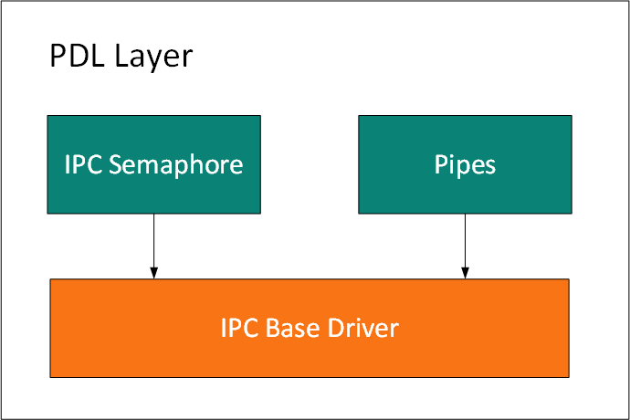
Block Diagram of IPC PDL
Notes:
The communication between more than one thread (CPU or task) is supported using an IPC driver. It implements two common methods, typically available in RTOS environments for thread interactions:
Semaphore (binary): used to regulate accesses to shared resources between two or more threads or used for signaling between two tasks. This type of semaphore can assume only values 0 or 1. Any thread can take (value set to 1) or give (value set to 0) the semaphore.
Queue: used to send any type of data between the threads. The user can set the number of items in each queue and define the item size. It implements a FIFO mechanism in firmware.
The IPC HAL driver will be built on top of the IPC PDL driver. The primary purpose of the IPC HAL driver is to provide a consistent, easy to use, API for customers to quickly implement their multiple CPU requirements, and for middleware that requires code to run on multiple CPUs

Slide 51
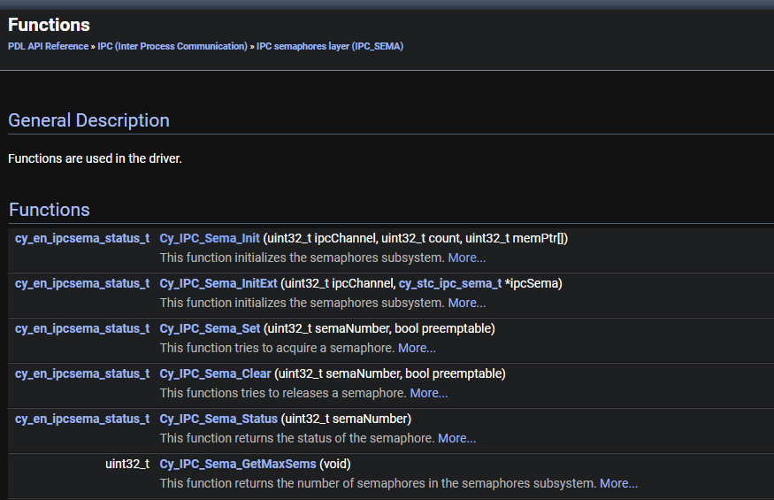
IPC PDL (Peripheral Abstraction Layer) Functions
Notes:
Here are the IPC Peripheral abstraction layer APIs for binary semaphores

Slide 52
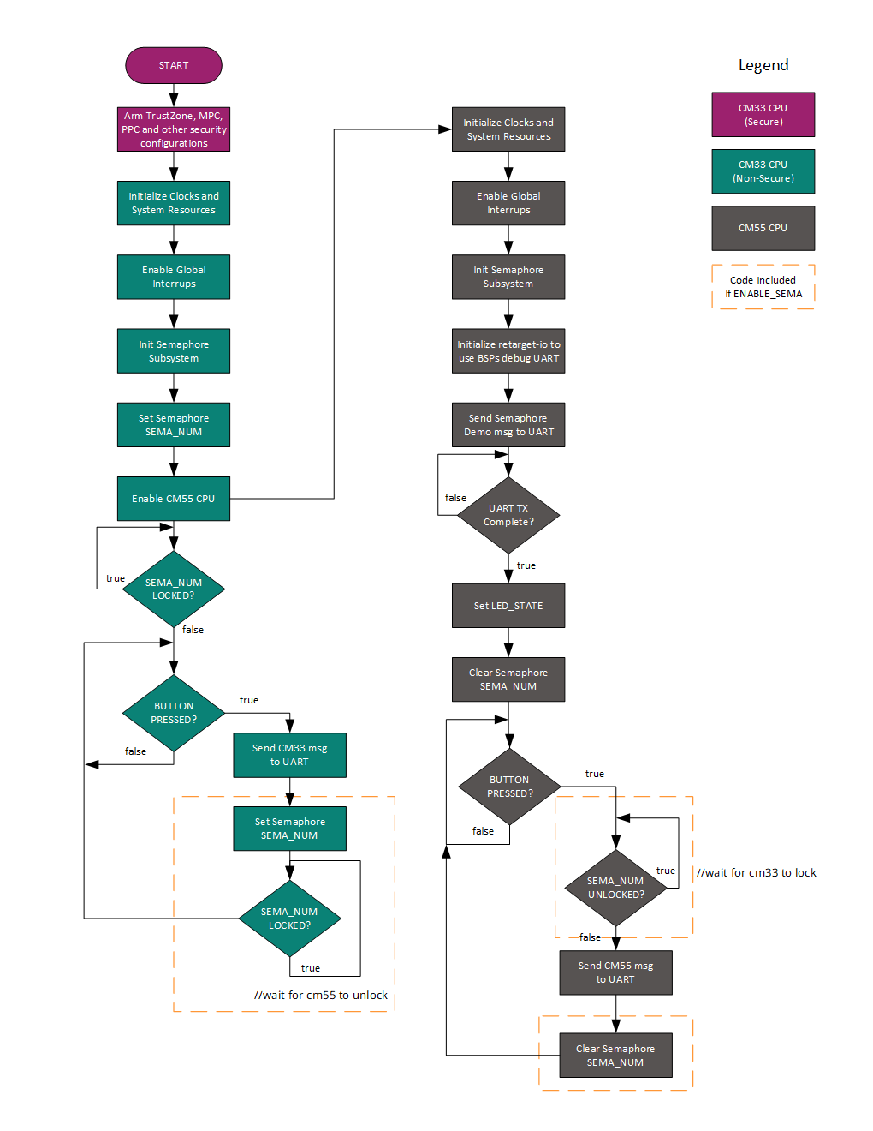
Flow chart
Notes:
Lets look at the flow chart
Presenter will explain the flow chart

Slide 53
Thank you!
Stay tuned for more trainings…
Join with us on our mission to drive decarbonization and digitalization Together.

